Slide 1

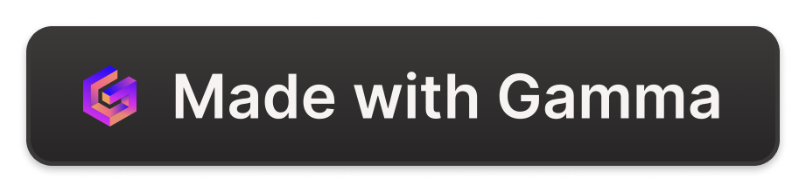
Web 3 NFT Card Game by DAppSorcerers
Welcome to the immersive world of the Web 3 NFT Card Game, designed by DAppSorcerers. Enter a realm of magic, strategy, and adventure.

Slide 2

Overview of Web 3 NFT Card Game
1
Unique Gameplay
2
Collectible NFT Cards
3
In-Game Economy
Experience battles, strategic decision-making, and endless entertainment with our cutting-edge blockchain-powered card game.
Participate in the vibrant in-game economy by trading and selling your NFT cards for valuable rewards.
Discover an expansive collection of NFT cards, each with unique abilities and varying levels of rarity.

Slide 3

Introduction to DAppSorcerers
1
Innovative Developers
2
Cutting-Edge Technology
Meet the creative minds behind the Web 3 NFT Card Game. DAppSorcerers leverage their expertise to build immersive experiences.
Experience the seamless integration of blockchain, Vite, React.js, Tailwind CSS, and smart contracts into the game's development.
3
Passion for Gamification
DAppSorcerers are dedicated to creating captivating gaming experiences that push the boundaries of what's possible.

Slide 4
Technology Stack
Vite
React.js
Utilizing Vite for fast and scalable blockchain solutions, allowing for a seamless gaming experience.
Building dynamic and interactive user interfaces with React.js, enhancing the game's visual appeal and user engagement.
Tailwind CSS
Avalanche Blockchain
Harnessing the flexibility and responsiveness of Tailwind CSS to ensure smooth and visually stunning design.
Implementing smart contracts on the Avalanche blockchain, ensuring security, reliability, and efficiency.

Slide 5
Features of the Card Game
Unique NFT Cards
Battles and Strategy
Immerse yourself in a vast collection of NFT cards, each possessing unique abilities, stunning artwork. and varying levels of rarity.
Engage in exhilarating battles, where strategic decisions and tactical maneuvers determine victory.
Trading and Collecting
Rewards and Economy
Participate in the expansive marketplace, trading and collecting NFT cards to enhance your collection and reap rewards.
Earn enticing rewards, upgrade your NFT cards, and shape the in-game economy through your actions and decisions.

Slide 6
Benefits of Web 3 and NFTs
Ownership and Verifiability
Interoperability and Cross-Platform
Decentralization and Security
With Web 3 and NFTs, players can truly own their digital assets, ensuring scarcity, authenticity, and verification.
Web 3 NFT Card Game enables seamless cross-platform capabilities, allowing players to engage and trade across different platforms.
The game's transactions are securely stored on the decentralized Avalanche blockchain, ensuring the highest level of security and transparency.

Slide 7

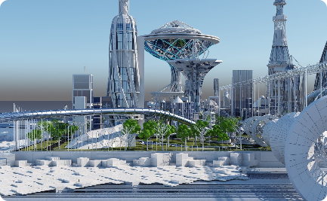

Conclusion
Recap of Key Points
Future Prospects
Q&A
We explored the innovative Web 3 NFT Card Game by DAppSorcerers, highlighting its unique features and benefits.
As the realm of Web 3 continues to expand, the game's potential for growth and exciting developments is virtually limitless.
We invite you to share your thoughts, ask questions, and delve deeper into the boundless possibilities of the Web 3 NFT Card Game.

